Slide 1
Expanding the scope of design patent protection
Intellectual Property Office
Chinese Taipei
January 2013

Slide 2
Background
To meet the needs of industry and current practices
To boost domestic development in culture and creative industries
To be in line with international practices

Slide 3
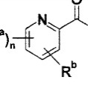
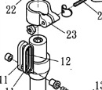
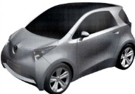
Current system
Industrial design is protected under the Patent Act.
Invention Patent
Utility model Patent
Design Patent
Substantive examination is necessary for design patent applications.
Formality Check
Substantive Examination
Issuance & Maintenance
Annual number of design patent applications (7,736 in 2011)

Slide 4
Expansion of design patent protection
partial designs
computer-generated icons and graphical user interfaces (icons & GUIs)
the design of a set of articles

Slide 5
Expansion of design patent protection
Allowing partial design and graphic image design
Before
After
（Definition of design）
（Definition of design）
“Design” … an article through visual appeal.
"Design" : …an article as a whole or in part by visual appeal.
For computer generated icons (Icons) and graphic user interface (GUI) applied to an article, an application may also be filed pursuant to this Act for obtaining a design patent.

Slide 6
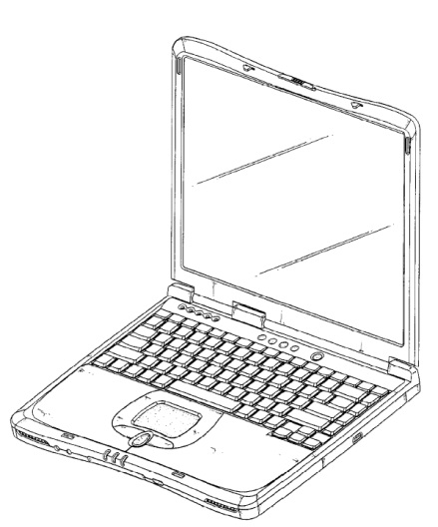
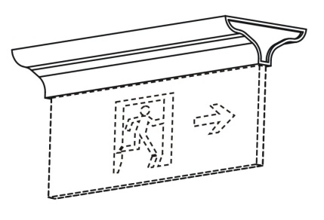
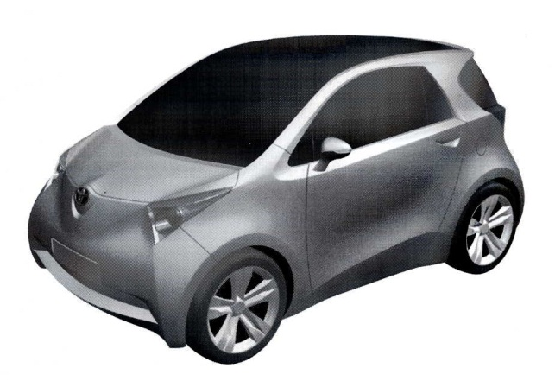

Expansion of design patent protection
Design patent
Partial Design patent
TW D114824, laptop
Base of indicator (LED Exit Light)
TW D129874, automobile
Portion of shoes

Slide 7

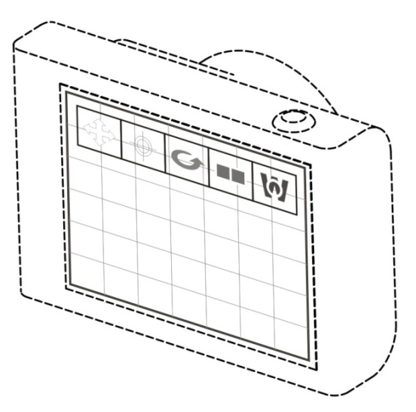
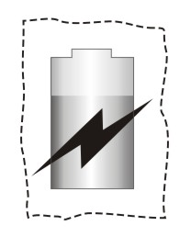
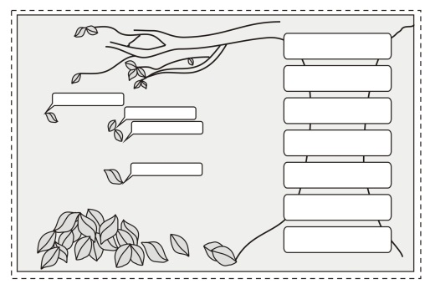
Expansion of design patent protection
Icon
GUI
Display screen portion with Icon
Digital camera with GUI
Display screen portion with Icon
Display panel with GUI

Slide 8
Expansion of design patent protection
Allowing design for a set of articles
Before
After
（One application one design）
（One application one design）
An application for a design patent shall relate to one design.
An application for a design patent shall relate to one design.
（Design for a set of articles）
Two or more articles belonging to the same class and are customarily sold or used together may be filed as for one design.

Slide 9
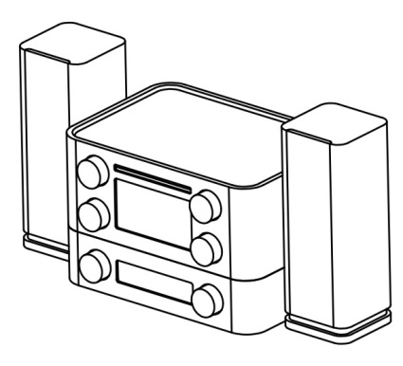
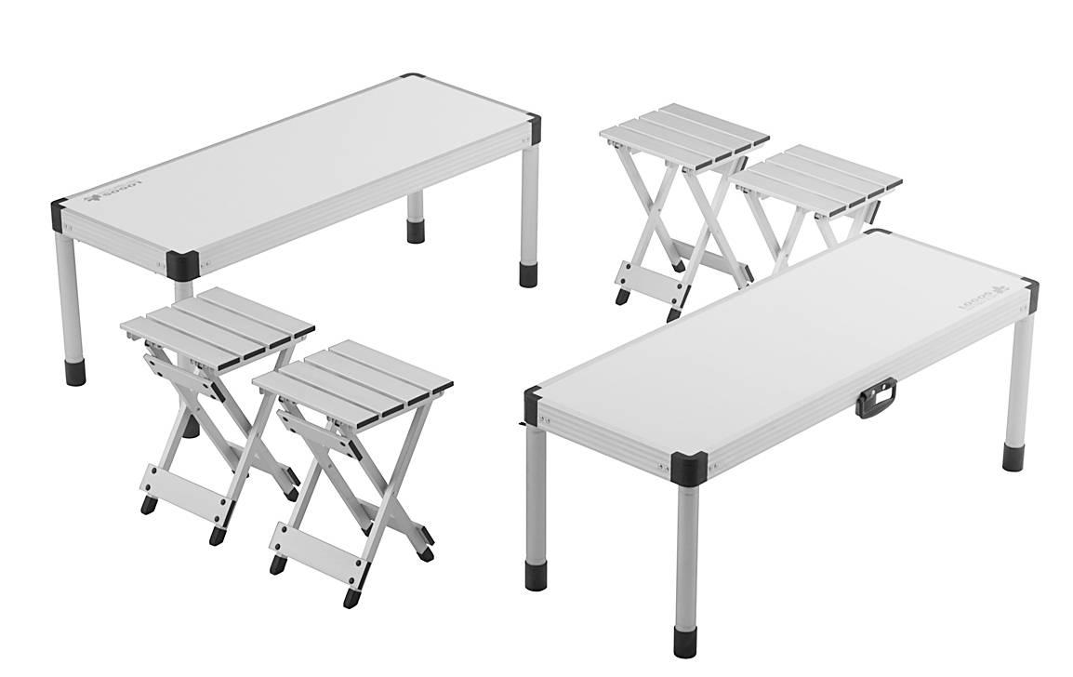
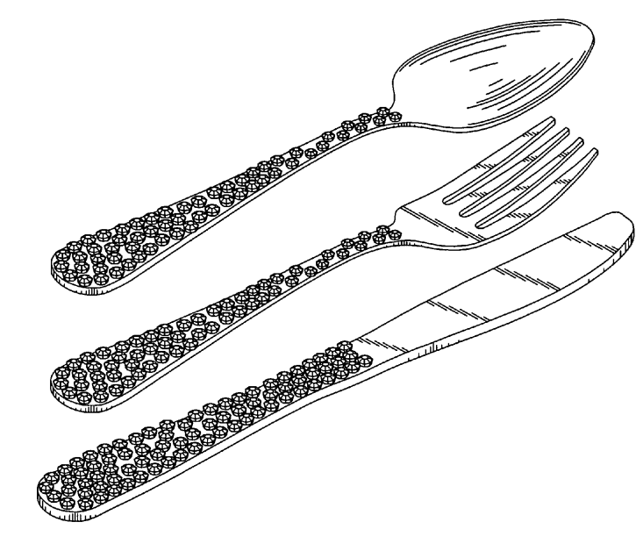
Expansion of design patent protection
The design of a set of articles
A set of audio appliances
JP D1356648, Outdoor table set
US D602312 , Flatware set

Slide 10
Expansion of design patent protection
Deleting the exclusion of artistic crafts
Before
After
（Statutory exclusion）
（Statutory exclusion）
…solely dictated by its function…
a fine art creation or artistic work;
the layout of electronic circuits…
…contrary to public order or morality.
…similar to political party flag or...
…solely dictated by its function…
an fine art creation;
the layout of electronic circuits…
…contrary to public order or morality.

Slide 11
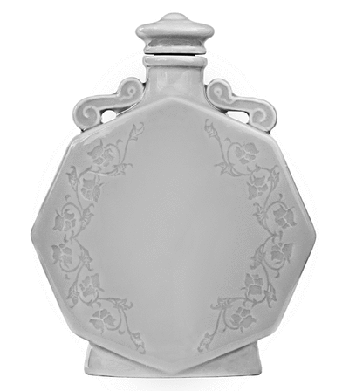
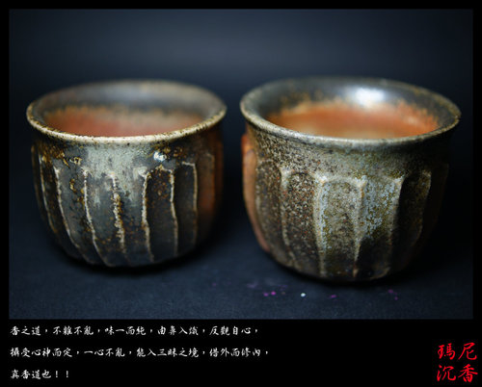
Expansion of design patent protection
artistic work
Such works shall meet the requirements of industrial applicability (for practical use)，...
JP D1441329, container
http://tw.myblog.yahoo.com/jw!DD9MpbeFEwTOpQVQs79Xgw--/article?mid=1360

Slide 12
Thank you!
HSU,Chia-Hung
vip20239@tipo.gov.tw

