Slide 1
“Bad Faith” Trademark Filings/Registrations:
TIPO’s Solution
Jeffrey CHEN
TIPO, Chinese Taipei
37th IPEG Meeting in Medan

Slide 2
Definition
Definition of “bad faith” in trademark filings/registrations
[the person] knew of the well-known mark and presumably intended to profit from the possible confusion
Interpretation of Article 6bis of Paris Convention, Guide to the Application of the Paris Convention for the Protection of Industrial Property
actions contrary to “honest commercial practices”
an intention to take unfair advantage of a competitor
actions contrary to existing legal principles
to prevent a competitor from entering the market without a bona fide intention
Possible interpretations of Article 24.4,24.5 and 24.7 of TRIPS Agreement, Resource Book on TRIPS and Development
actions contrary to legal norms

Slide 3
How to deal with it?
Bad faith
filings/registrations
Examination Guidelines
Examination practices
Trademark Act 2011

Slide 4
Addressing bad faith filings
Trademark Act 2011
        Subparagraph 10, 11, 13 & 14 of Paragraph 1 of Article 30
  Grounds for refusal of registration
    another person’s registered trademark without his consent, and hence there exists a likelihood of confusion on relevant consumers
    another person’s well-known trademark without his consent, and hence there exists a likelihood of confusion on the relevant public
    another person’s portrait or well-known name, stage name, pseudonym, or alternative name without his consent
    the name of a well-known juridical person, business or any group without its consent, and hence there exists a likelihood of confusion on the relevant public

Slide 5
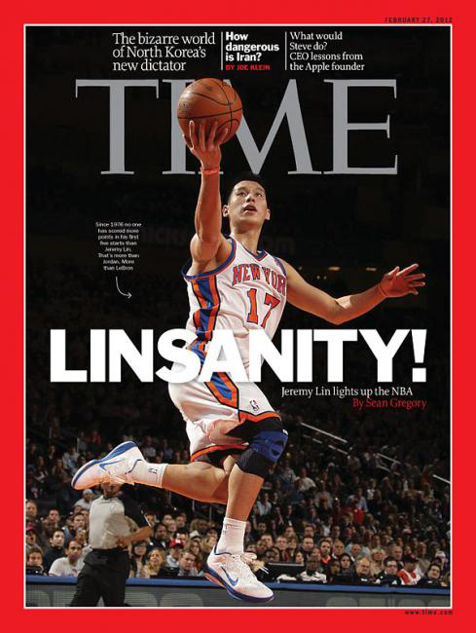
Case example #1
Jeremy Lin, “Linsanity”
Jeremy Lin is an American professional basketball player for the Houston Rockets of the National Basketball Association (NBA) now. In February 2012, he unexpectedly led a winning streak by New York while being promoted to the starting lineup, which generated a global following known as “Linsanity.”
At that time, lots of “Jeremy Lin” and “Linsanity” trademark applications filed without his consent in a few days. Those applications for registration were absolutely “bad faith” filings and has been refused by TIPO.

Slide 6
Addressing bad faith filings
(cont.)
Examination Guidelines on Likelihood of Confusion
  While determining the likelihood of confusion, TIPO may consider whether the application is filed in good faith.
  If an applicant is aware at the time of filing that his application may cause consumer confusion with respect to the source of goods/services, or he intends to cause confusion, such application(s) will not be filed in good faith.
  Ex:
    An applicant files a new application for registration after his earlier identical/similar registration has been transferred to another person with his/her consent or by compulsory execution or bankruptcy proceedings.
    An applicant who has been licensed to use another person’s trademark in English files an application for registration of a new trademark which is the translation/transliteration of the original one in Chinese.

Slide 7
Addressing bad faith filings
(cont.)
Examination practices:
Addressing bad faith application “filed later in time but in different classes”
Principle of “the classification of goods or services shall not constrain the determination of similarity” (Paragraph 6 of Article 19 of the Act)
Cross-class retrieve
“Similar goods/services” includes goods/services related in functions, raw materials, manufacturers or other characters

Slide 8
Addressing bad faith registrations
Opposition/Invalidation
Trademark Act 2011
  Besides grounds for refusal which are used to address bad faith filings, there are other grounds used in opposition and invalidation procedures to address bad faith registrations:
        Subparagraph 11 & 12 of Paragraph 1 of Article 30
  registering another person’s well-known trademark without his consent, and hence there exists a likelihood of dilution of the distinctiveness or reputation of the said well-known trademark
  registering another person’s earlier used trademark without his consent, and the applicant files the application for registration
    being aware of the existence of the earlier used trademark due to contractual, regional, or business connections, or any other relationship with the proprietor of the earlier used trademark
    with the intent to imitate the earlier used trademark

Slide 9


Case example #2
THE IMFAMOUS BLACK SHEEP BRAND v. BLACK SHEEP
informal footwear, sneakers purses, wallets, backpacks
Opponent Registrant
Both the opponent and registrant are competitors in fashion industry.
The opponent’s trademarked goods have been imported, advertised and sold for years.
The opponent’s trademark, which contains the combination of the coined device element and the term “BLACK SHEEP,” is unique.
It is hardly possible that the registrant wasn’t aware of the existence of the opponent’s trademark and didn’t intend to imitate such trademark.

Slide 10


Case example #3
Red and Golden Dragon in simplified Chinese
Goods: tobacco products
The registrant’s trademark is identical to the opponent’s trademark.
The opponent’s trademark is well-known in Mainland China.
The registrant is a national of Mainland China and planning to do tobacco related business in our territory.
It is hardly possible that the registrant wasn’t aware of the existence of the opponent’s trademark and didn’t intend to imitate such trademark.

Slide 11
Addressing bad faith registrations (cont.)
Trademark Act 2011
Bad faith registration against a well-known trademark can be invalidated even after five years of registration (Paragraph 2 of Article 58)

Slide 12
Addressing bad faith registrations (cont.)
Examination Guidelines regarding Likelihood of Dilution
  While determining the likelihood of dilution, TIPO may consider whether the applicant has the intent to make his trademark to be associated with another person’s well-known trademark.
  Ex:
    If an applicant deliberately enlarges or boldfaces a particular word or device element of his trademark and that element is identical to another person’s well-known trademark, the applicant’s intent to make his trademark as being associated with such well-known trademark can be presumed.

Slide 13
Addressing bad faith registrations (cont.)
Other measures in relation to bad faith registrations
Proprietor’s obligation to use his registered trademark
Revocation for non-use (Article 36 of the Act)
A person who files invalidation shall proof the use of his own trademark (Paragraph 2 of Article 57 of the Act)
Examination practice on suspension of examination/disposition if the related/cited registrations face challenges (opposition, invalidation or revocation)

Slide 14
Thank You!
Jeffrey CHEN
TIPO

